Slide 1
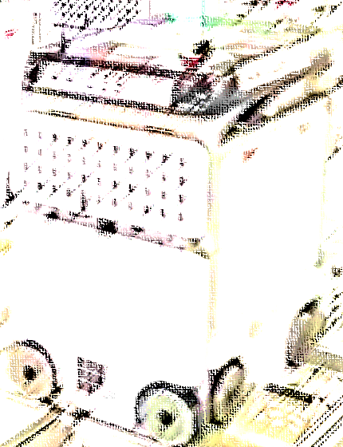
This enormous warehouse is manned by intelligent robots
Dr. Yüksel YURTAY

Slide 2
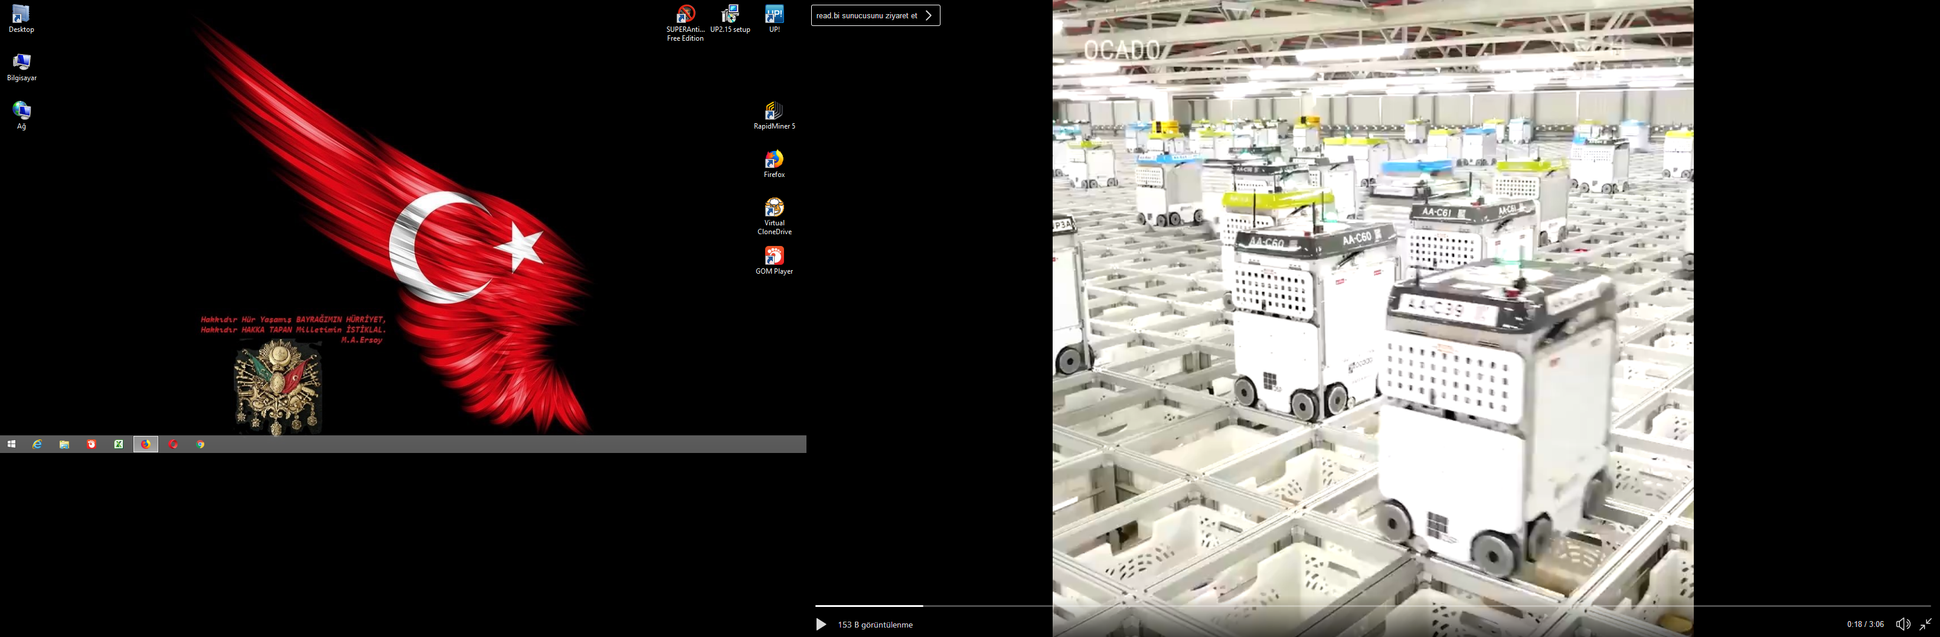

Slide 3
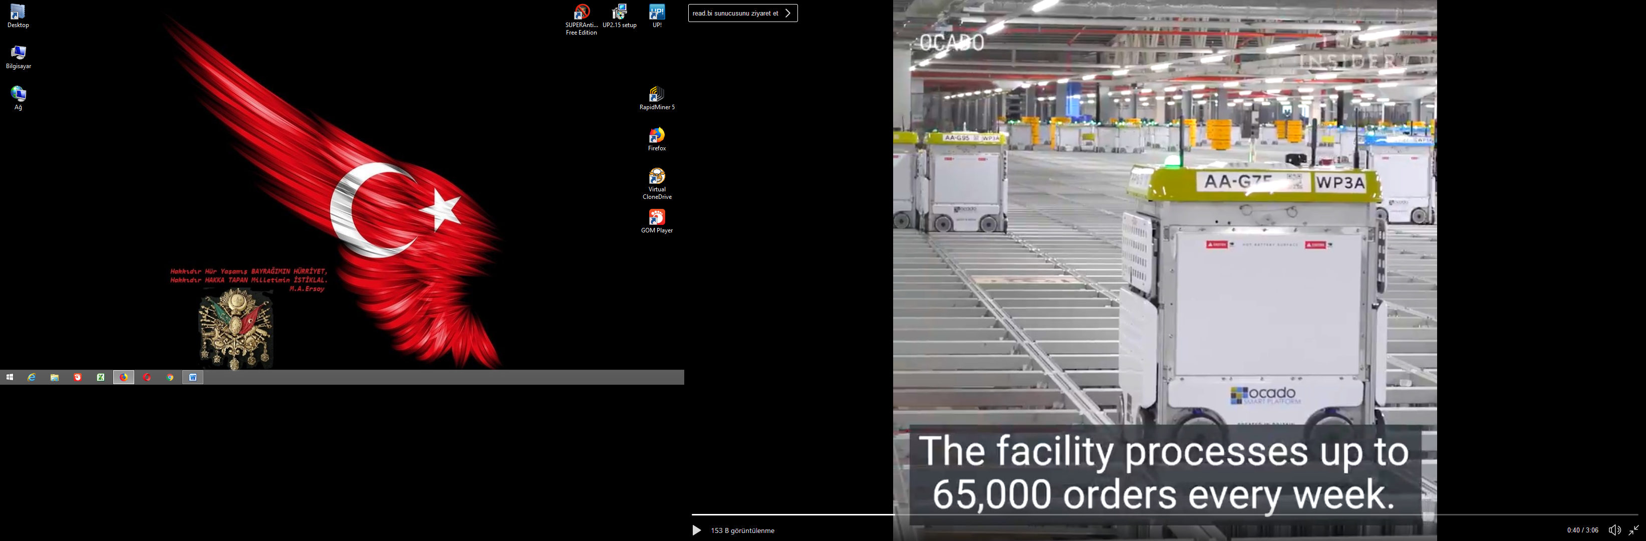

Slide 4
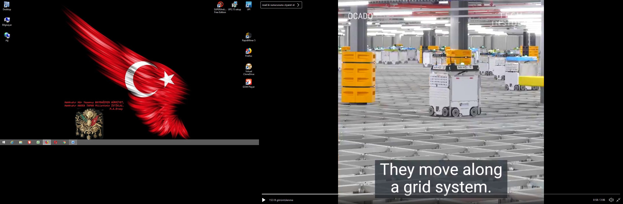

Slide 5
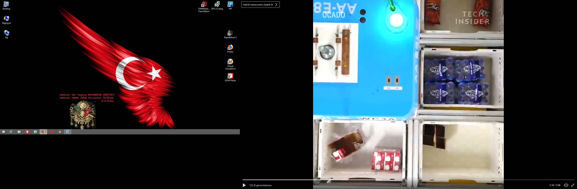

Slide 6
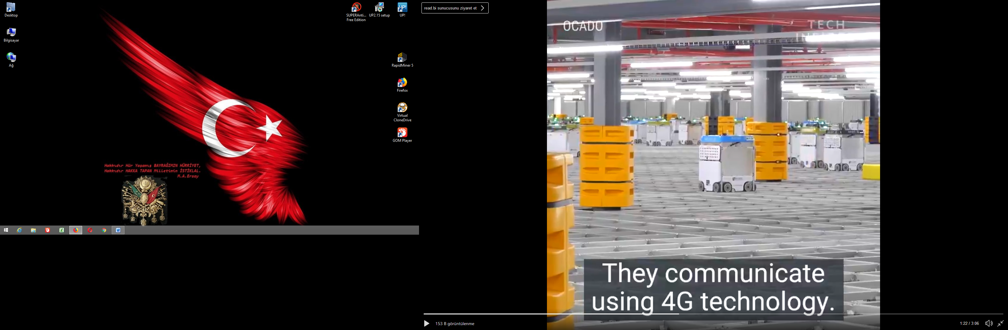

Slide 7
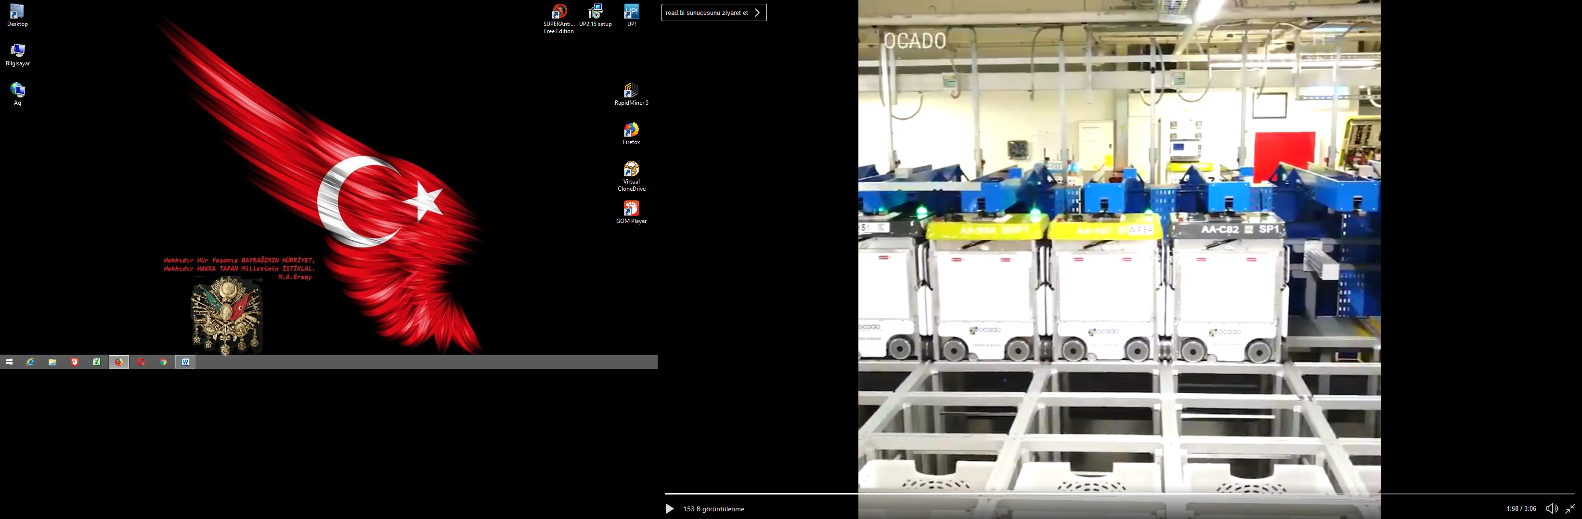

Slide 8
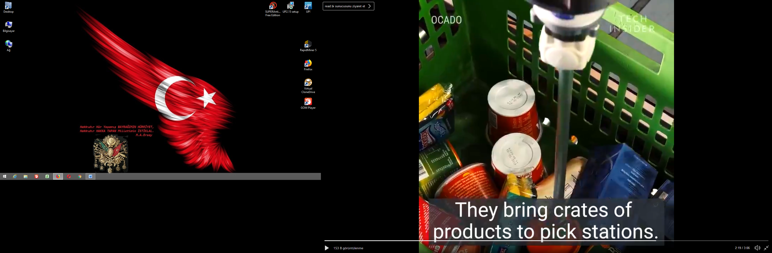

Slide 9


Slide 10

 | Tech Insider (@techinsider)
14.10.2018 09:22 This enormous warehouse is manned by intelligent robots which pack groceries pic.twitter.com/rWS1PZfDP0

